Slide 1
Powershell File Processing
PowerShell File Processing Summary
1. Text Files (.txt)
2. CSV Files (.csv)
3. JSON Files (.json)
4. Word Documents (.docx)
5. Excel Files (.xlsx)

Slide 2
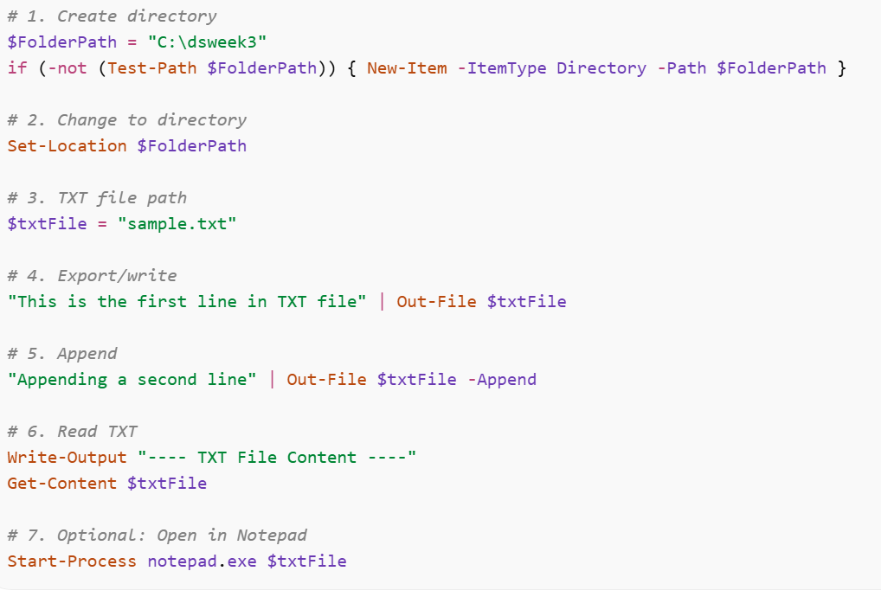
1. Text Files (.txt)
Get-Process |out-File $txtFile -Append
Start-Process notepad.exe $txtFile

Slide 3
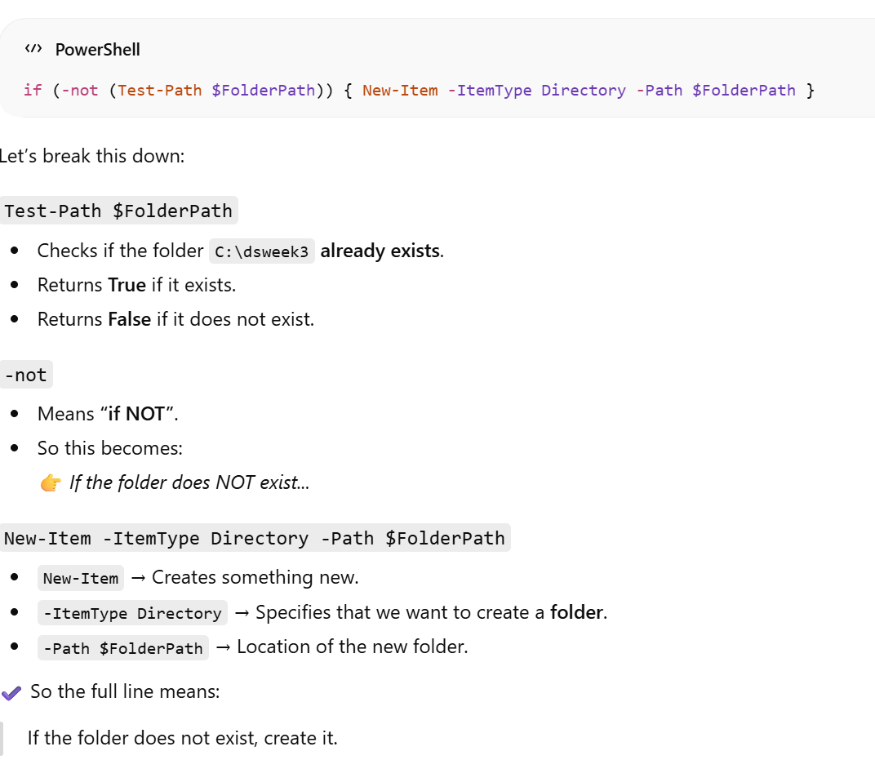
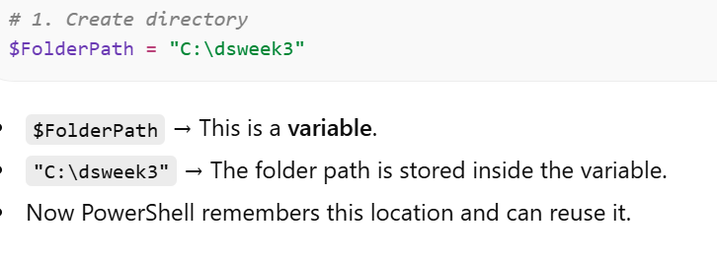
✅ 1. Create Directory

Slide 4
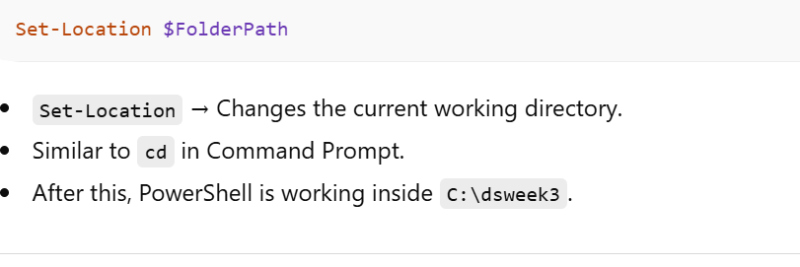
✅ 2. Change to Directory

Slide 5
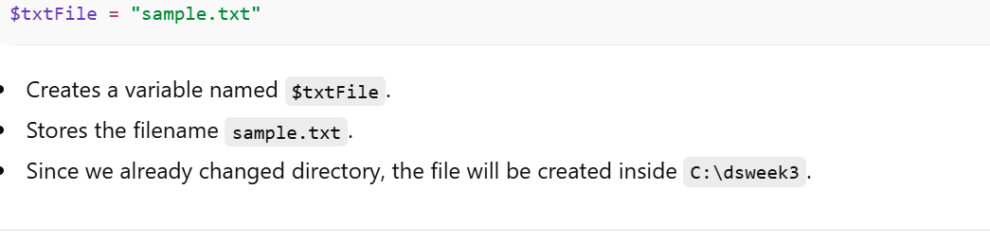
✅ 3. TXT File Path

Slide 6
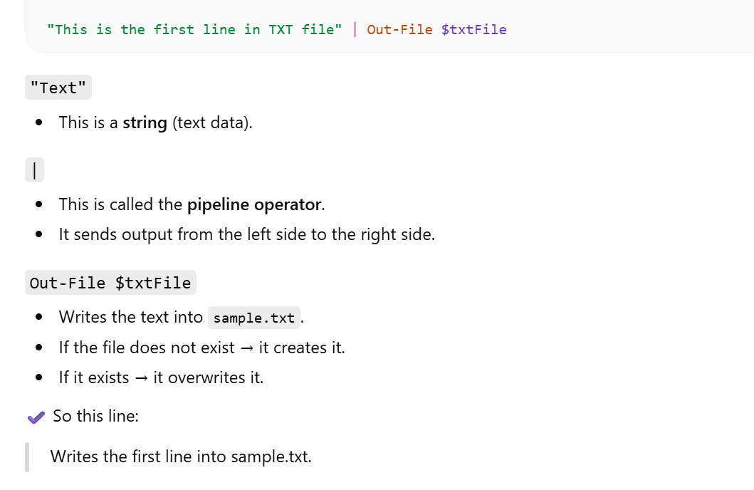
4. Export / Write to File

Slide 7
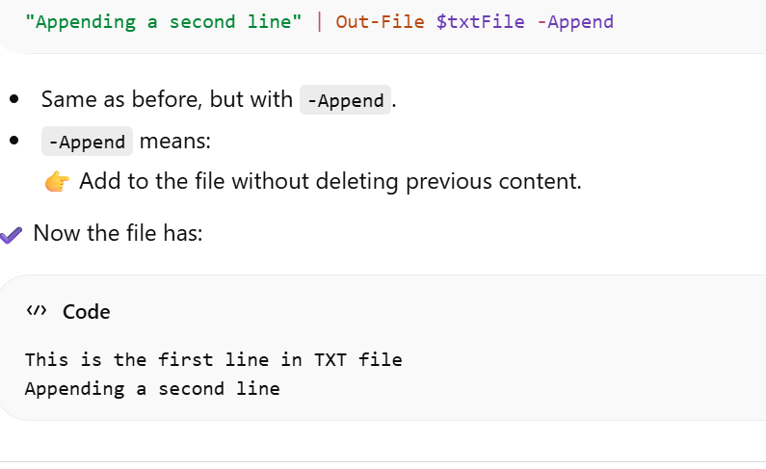
✅ 5. Append to File

Slide 8
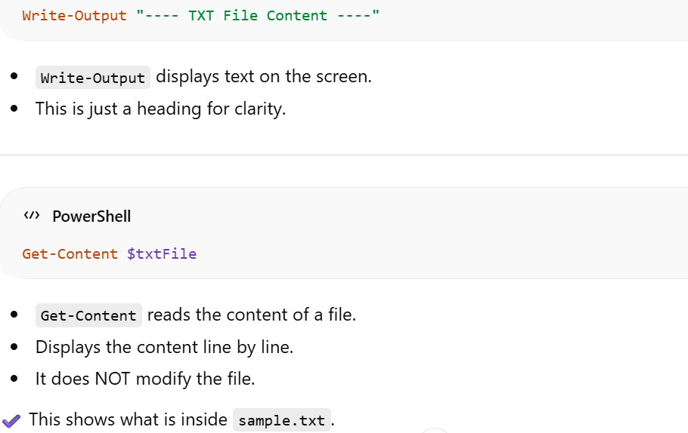
✅ 6. Read TXT File

Slide 9
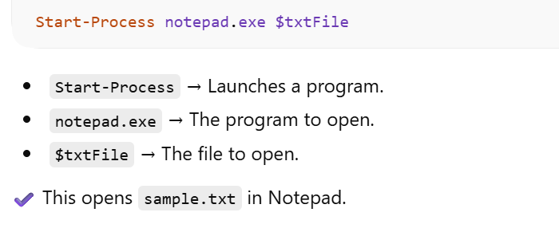
✅ 7. Open File in Notepad

Slide 10
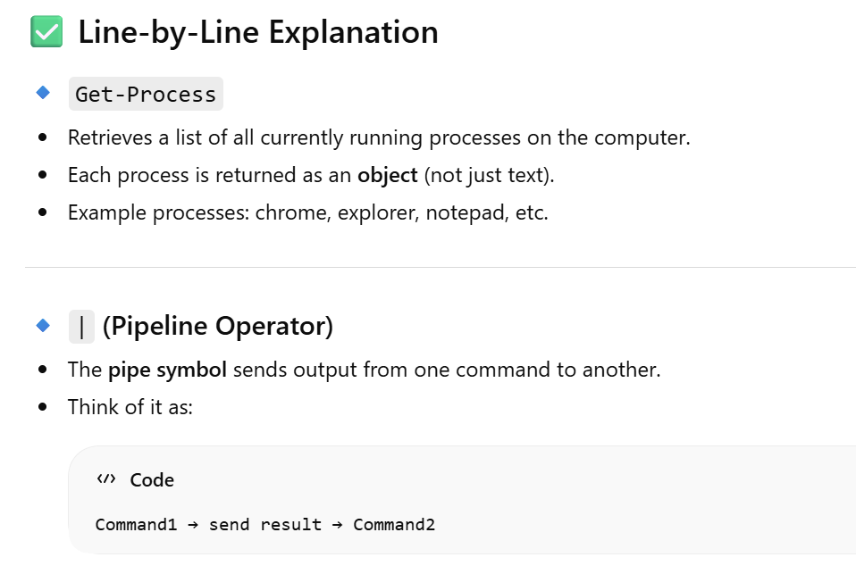
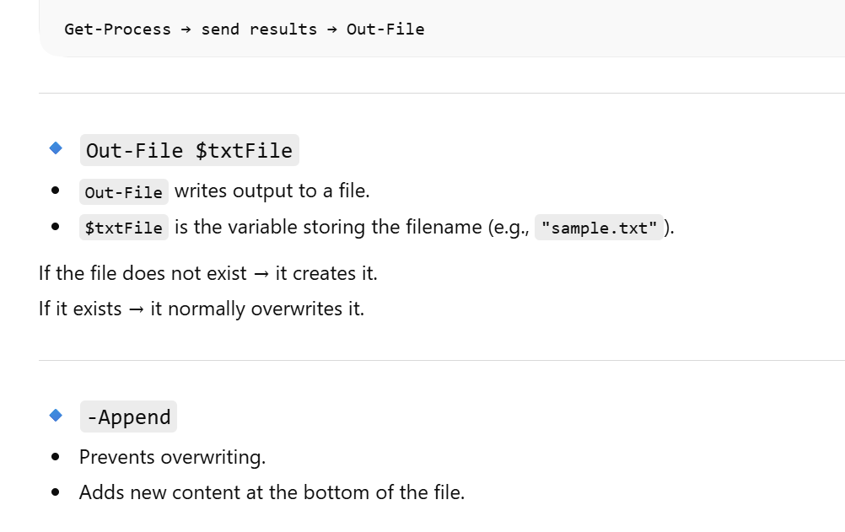
✅ Get-Process | Out-File $txtFile -Append

Slide 11
Practice these commands
Get-Service
Get-EventLog
Get-ChildItem
Get-ComputerInfo
Get-Date
Get-LocalUser
Get-NetIPConfiguration
Get-Command
Get-Module
Get-HotFix

Slide 12
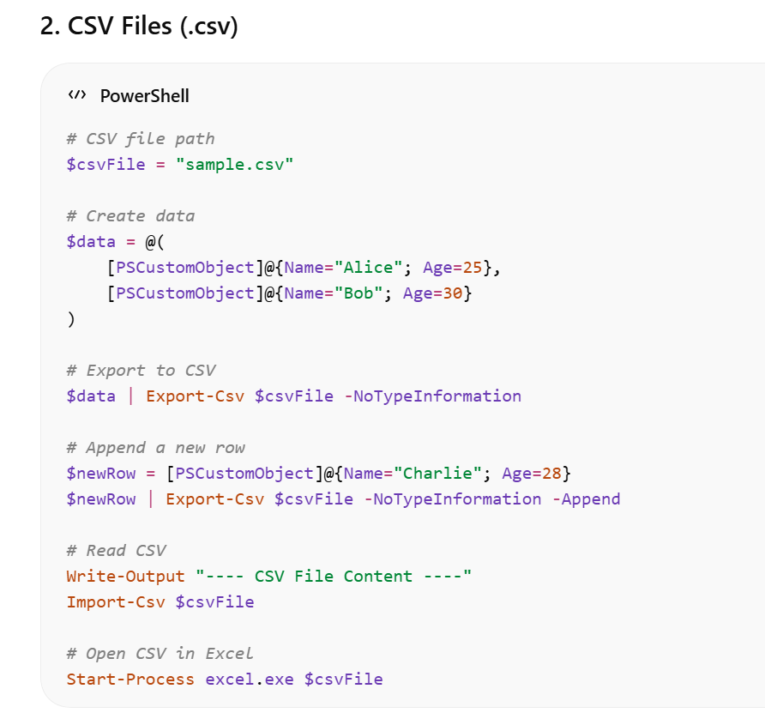
2. CSV Files (.csv)

Slide 13
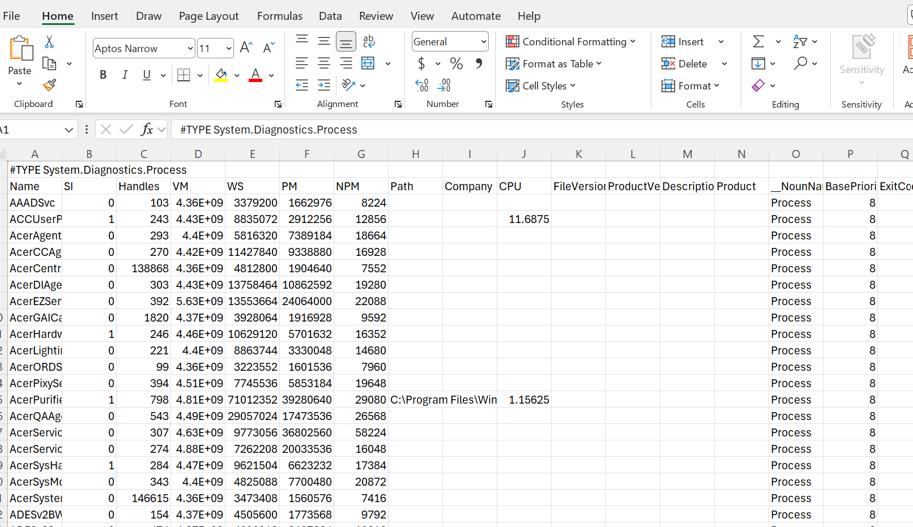

Get-Process |Export-csv sampleExcel.csv
5. Excel Files (.xlsx)

Slide 14
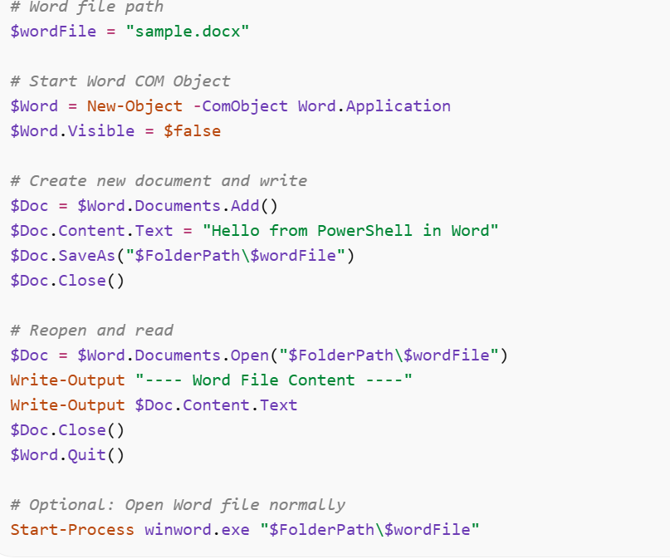
4. Word Documents (.docx)

Slide 15
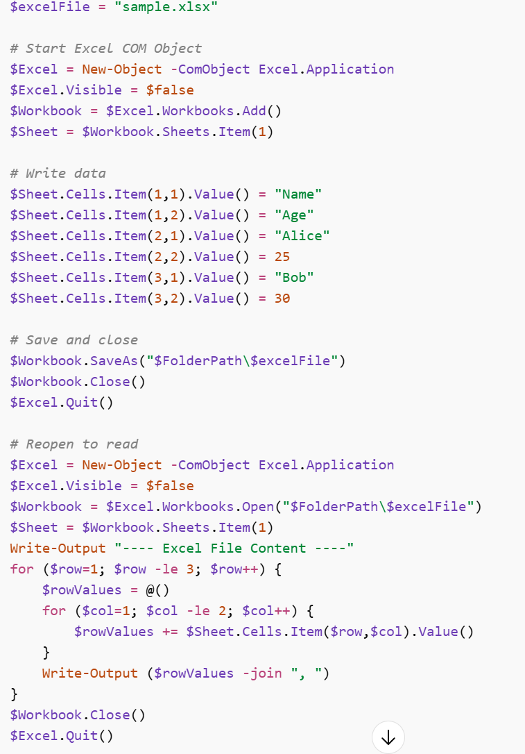

5. Excel Files (.xlsx)

Slide 16
Questions
Text File (.txt) –
Creating and Writing Text Files Write a PowerShell script that creates a folder C:\dsweek3, changes to it, and writes the following lines to a file called students.txt:
Alice Bob Charlie
Then, read the file content and display it on the console.
Appending Text Modify the script from Q1 to append the names David and Eve to the students.txt file without overwriting existing content. Display the updated content.
Exporting Command Output Write a PowerShell command to export the list of currently running processes to a text file called processes.txt in the C:\dsweek3 directory. Then, read the file to verify the output.
Opening Text Files Using PowerShell, write a script to open the students.txt file in Notepad. Explain what happens if the file does not exist.

Slide 17
Questions
CSV File (.csv)
Creating CSV Files Write a PowerShell script to export the following data to students.csv:
Appending Rows to CSV Extend the script from Q5 to add another row: Name = Charlie, Age = 28. Verify the updated CSV content.
Exporting Objects to CSV Write a script to export the output of Get-Process to processes.csv. Include only the columns Name, Id, and CPU. Read the CSV and display the first 5 rows.
Opening CSV Files in Excel Write a script that opens the students.csv file in Excel using PowerShell. Explain what command is used and why.
Name | Age
Alice | 25
Bob | 30
Then read the CSV file and display its content in a table format.

Slide 18
Text File (.txt) – 2 Questions
Q1. Creating, Writing, and Exporting Data Write a PowerShell script that:
Creates a folder C:\dsweek3.
Changes the current directory to it.
Writes the following lines to a file called students.txt:
Alice
Bob
Charlie
Uses Get-Process to export all running processes to a file called processes.txt using Export-Csv.
Reads both students.txt and processes.txt and displays their content on the console.

Slide 19
Q2. Appending and Opening Files Modify the script from Q1 to:
Append the names David and Eve to the students.txt file using Out-File -Append.
Add another process entry (e.g., using Get-Process | Select-Object Name, Id, CPU | Export-Csv -Append) to processes.txt.
Open students.txt and processes.txt in Notepad using Start-Process.

